Slide 1

Home Depot Product Search Relevance
Jinwei Kang

Slide 2
Project Overview
Success is walking from failure to failure.
1
2
3
4
5
Introduction
Data
Text Pre-Processing
Feautres
Predictive Model
.

Slide 3
Introduction
Home Depot want to improve their customers' shopping experience by developing a model that can accurately predict the relevance of search results.
Search relevancy is an implicit measure Home Depot uses to gauge how quickly they can get customers to the right products.

Slide 4
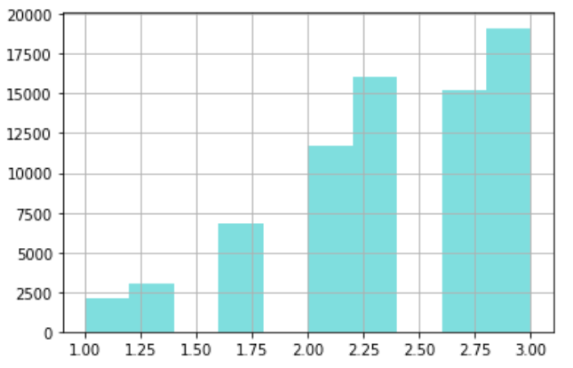
Data Overview
train.csv - the training set, contains products, searches, and relevance scores
product_descriptions.csv - contains a text description of each product
attributes.csv - provides extended information about a subset of the products

Slide 5
Text Pre-Processing
Spell Checking: correct the spelling of the search terms
Column of Brands: created the name of the brands column
General Processing: splitting words, lowercase, removing special characters, removing text between parentheses/brackets, replacing word numbers to numerical expression, and standardize the unit's representations
Removing Tags: removing HTML tags

Slide 6
Text Pre-Processing
Removing Accented Characters: converted and standardized into ASCII characters.
Tokenization: tokenizing or splitting a string, text into a list of tokens.
Stemming: converted to base form of words as root stem
Lemmatization: converted to base form of words as root word
Removing Stop Word: words like a, an, the, and so on are considered to be stop words

Slide 7
Total of 34 features
Length of words
Word matching counts,
Words ratio
TF-IDF,
Cosine distance of Word2Vec, Doc2Vec, and FastText
Jaccard distance
Levenshtein distance
Features
A total of 34 features

Slide 8
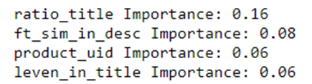
Top 4 important feature for random forest model
ration_title: the ratio of the number of the number of matching words in the product titles and search terms
ft_sim_in_desc: the consine distance between product descriptions and search terms based on a FastText model
product_uid: product ID
leven_in_title: the Levenshtein distance between product titles and search terms
Features for Random Forest
A total of 34 features

Slide 9
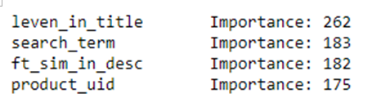
Top 4 important features for LightGBM model
leven_in_titile, ft_sim_in_desc, and product_uid are both important in random forest and lightGBM model
Features for LightGBM
A total of 34 features

Slide 10
Predictive Model
LightGBM performed the best with RMSE 0.4530
Bagging performed the second best with RMSE 0.4744
Algorithms | RMSE
Lasso | 0.5251
Elastic Net | 0.5250
Ridge Regression | 0.4659
SVR | 0.5529
Bagging | 0.4744
Random Forest | 0.4761
AdaBoost | 0.4794
Gradient Boost | 0.4794
XGBoost | 0.4576
LightGBM | 0.4530
Voting Regression | 0.4576

Slide 11
Hyperparameter Tuning
Random Forest:
After hyperparmeter tuning, LightGBM performed the best with RMSE 0.4530
After hyperparmeter tuning, random forest performed the best with RMSE 0.4552
Parameter | Value
bootstrap | False
max_depth | 11
max_features | sqrt
min_samples_leaf | 1
min_samples_split | 2
n_estimators | 1600
LightGBM:
Parameter | Value
learning_rate | 0.05
max_bin | 64
max_depth | 15
min_data_in_leaf | 40
num_leaves | 200

Slide 12
Final Model
After stacking random forest and lightGBM models, the final model with lightGBM performed the best with RMSE 0.4521
Private score：0.46185 on Kaggle
Ranked #134 among 2124 participants

Slide 13
THANK YOU

